Slide 1
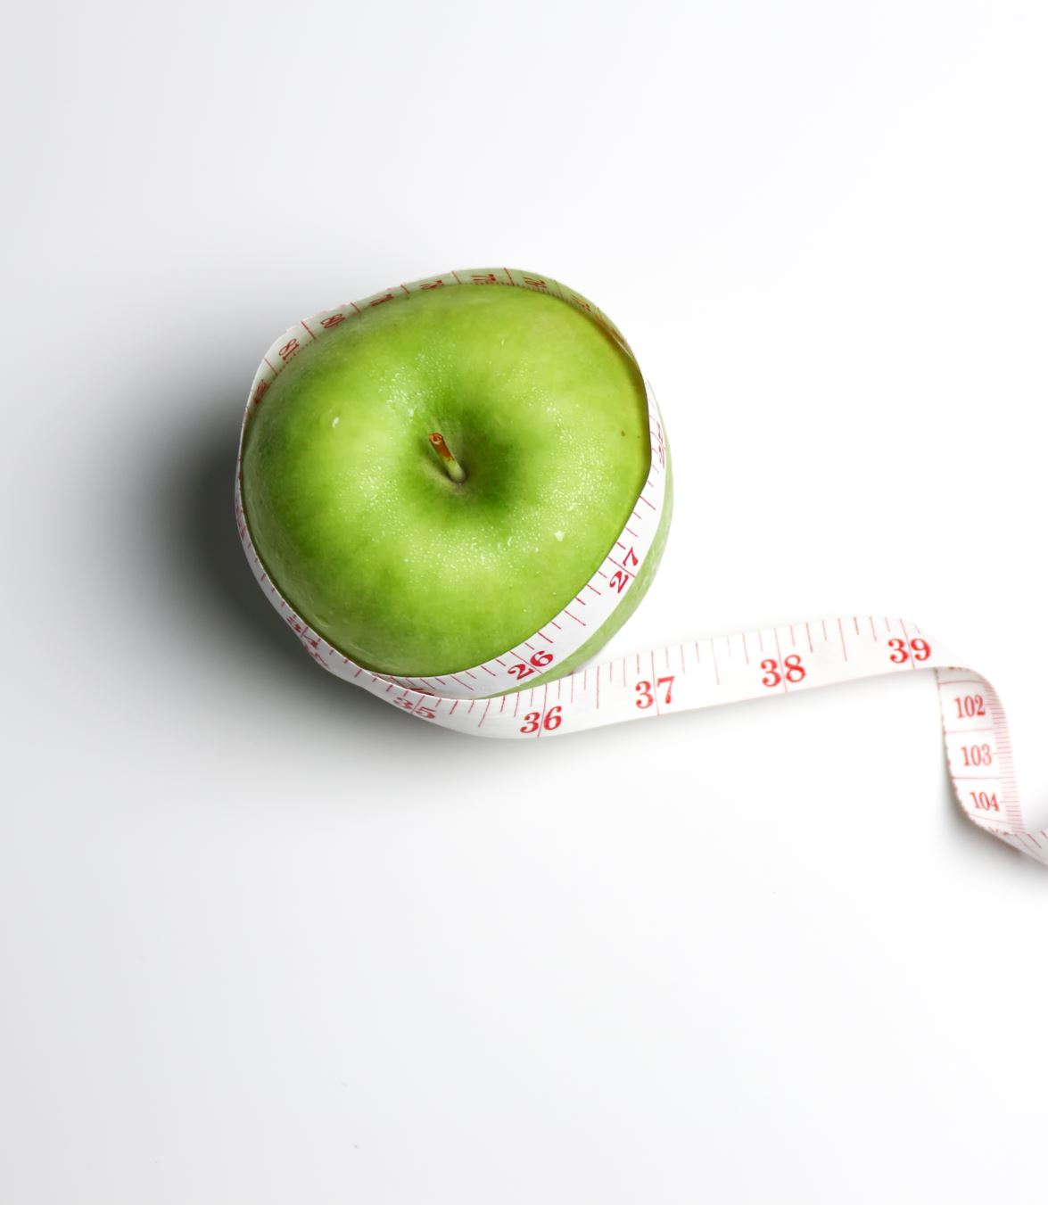
Dietary Advice For Optimal Health During Pregnancy

Slide 2
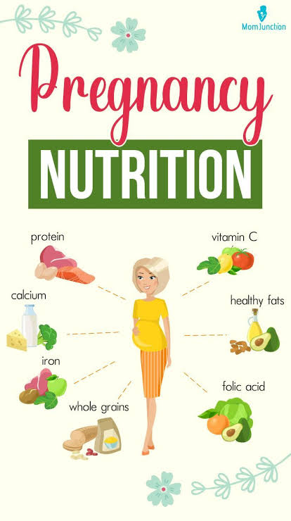
By Mrunal Khambale
&
Parmeshwar Kendre

Slide 3
Why Is It Important to Gain the Recommended Amount of Weight During Pregnancy?
Gaining less than the recommended amount of weight in pregnancy is associated with delivering a baby who is too small. Some babies born too small may have difficulty starting breastfeeding, may be at increased risk for illness, and may experience developmental delays.
Gaining more than the recommended amount of weight in pregnancy is associated with having a baby who is born too large, which can lead to delivery complications, cesarean delivery, and obesity during childhood. Gaining more than the recommended amount of weight can also increase the amount of weight you hold on to after pregnancy, which can lead to obesity.

Slide 4
Is it necessary to take a vitamin/mineral supplement during pregnancy?
  Though its possible to meet the requirements for most nutrients through a balanced diet, most experts recommend pregnant women to take daily vitamin supplements, including iron folic acid as a safe guard.

Slide 5
According to the Some National and international institutes supplementation should begin at the start of the second trimester at the following levels
Iron.....................30 milligrams (mg)
Folic Acid......400 micrograms (mcg)
Calcium...........250 mg
Vitamin C...50 mg
Vitamin B12........2 mcg
Vitamin D...5 mcg
Copper.2 mg
Zinc....15 mg
Vitamin B6....2 mg

Slide 6
About Folic Acid
Folic acid in a vitamin supplement, when taken one month before conception and throughout the first trimester, has been proven to reduce the risk for an NTD-affected pregnancy by 50% to 70%.
Folic acid, a B-vitamin, is necessary for proper cell growth and development of the embryo.

Slide 7

NTDs (Neutral Tube Defects)
Notes:
There are other causes as well of these diseases
But main factor is deficiency of folic acid

Slide 8
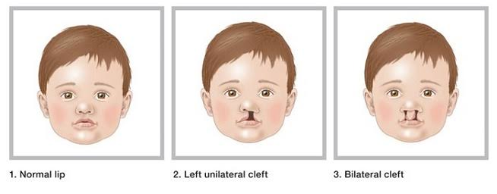
Cleft Lip And Palate
These things may increase your chances of having a baby with cleft lip or palate:
Family history of cleft lip and cleft palate. ...
Smoking or drinking alcohol during pregnancy. ...
Not getting enough nutrients like Folic acid, before and during pregnancy. ...
Having diabetes before pregnancy.

Slide 9
Folic Acid—important in cell development(a water soluble vitamin)
Recent research suggests that taking folic acid before and during early pregnancy can reduce the risk of spina bifida and other neural tube defects (NTDs) in infants.
All women of childbearing age that are capable of becoming pregnant should consume 400 micrograms (mcg) of folic acid daily to reduce their risk of having an NTD-affected pregnancy.

Slide 10
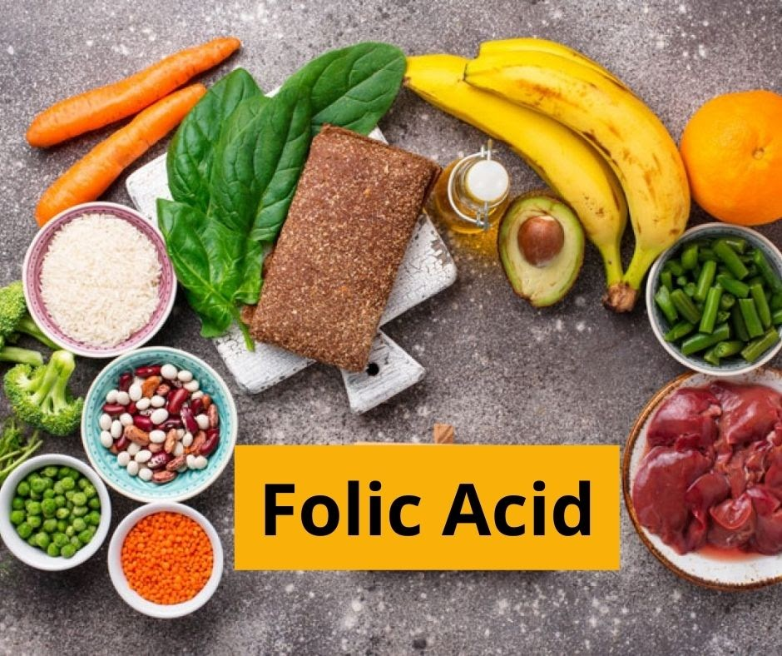
Foods rich in folate include
orange juice from concentrate,
dark-green leafy vegetables
(spinach, broccoli, asparagus, romaine lettuce)
other vegetables
(carrots, tomatoes, potatoes)
beans and pulses like black-eyed beans lentils
whole grains (i.e. Brown rice some cereals)
citrus, bananas, kiwis and strawberries,
liver
fish
eggs
milk

Slide 11
Calories
Calories—To support the rapid growth of the foetus, pregnancy demands an additional 300 calories a day over pre-pregnancy needs
This is approximately the same number of calories as supplied by
2 ½ cups of low-fat milk OR
1 cup of ice cream

Slide 12
Proteins
Protein Both the expectant mother and developing fetus need increased amounts of protein.
It is recommended that pregnant women consume 60 grams of protein a day. This is only 10 grams more than non-pregnant women.
Blood volume increases during pregnancy to supply baby's blood. Therefore, Mother should go for healthy protein that aren't high in fat

Slide 13
Protein sources
Seeds
Nuts
Beans, legumes
Grains
Sprouts
Eggs
Dairy Products
Fish
Lean Meats
Fowl

Slide 14
Iron
The iron requirement doubles during pregnancy
30 mg/day during the second and third trimesters
Additional iron is needed as a result of increased maternal blood volume. Also, the fetus stores enough iron to last through the first few months of life.

Slide 15
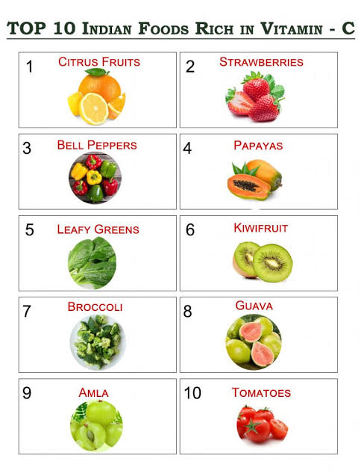
To Get the Most of Iron from One’s Diet
Eat high-iron meals with vitamin C or foods high in vitamin C (Taking 200-500 mg. Of vit C nearly doubles iron absorption).
Tannic acid, caffeine, and phosphates inhibit iron absorption avoid them
Avoid antacids they neutralize stomach acids which enhance iron absorption.

Slide 16
You can help reduce your risk of iron deficiency anemia by eating foods that contain iron all throughout pregnancy. These include
Red meats
Poultry (dark meat)
Eggs
Fortified breakfast cereals whole grain breads
(check the container to see if the cereal or
bread contains iron)
Blackstrap molasses
Green leafy vegetables
Baked potato, with skin
Cooked beans
Raisins, dates, prunes, figs, apricots

Slide 17

Vitamin A supplementation is not recommended during pregnancy
Excessive levels of Vitamin A can be toxic to the fetus
Adequate levels of Vitamin A are available through a balanced diet

Slide 18
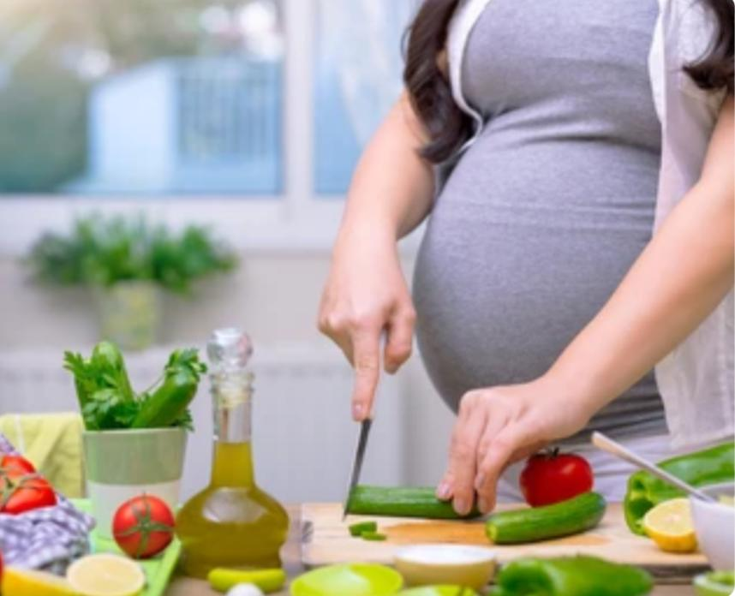
Pregnant women should use caution with vitamins
A, C, and D in higher doses than the recommended
daily allowances
Synthetic vitamin A in some drugs used for acne
and psoriasis can cause birth defects in the
developing fetus.
The concern with toxicity of vitamin D in
pregnancy is calcification of the placenta and
other soft tissues. The mother is also more prone
to developing kidney stones.
Vitamin C taken in extra large doses is thought
to cause miscarriage in the early weeks of
pregnancy and can cause harm to the baby after birth

Slide 19

Caffeine in Pregnancy
Some studies suggest that drinking more than 2 to 3 cups of coffee daily increases the chances of low birth weight.
Watch for hidden caffeine in teas, soft drinks, chocolate products.

Slide 20
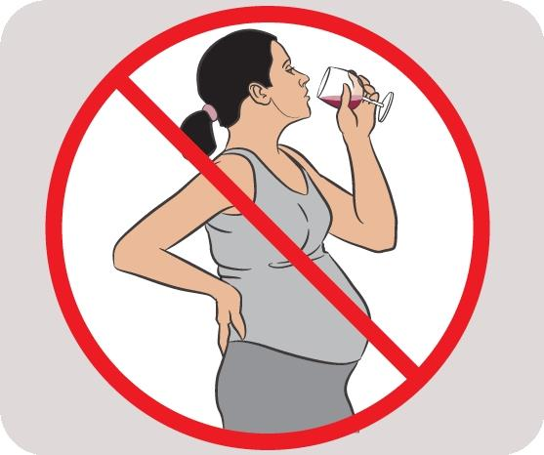
Alcohol Use in Pregnancy
Women who use alcohol during pregnancy have a
greater risk of giving birth to babies with fetal
alcohol effects (FAE) or the more serious fetal
alcohol syndrome (FAS).

Slide 21
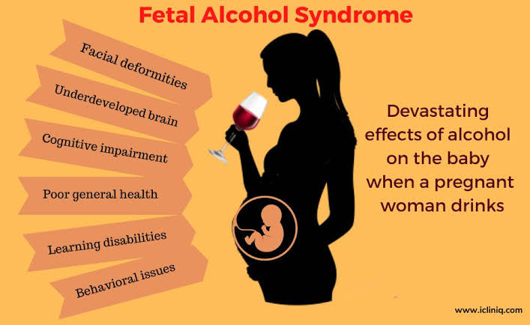
Fetal Alcohol Syndrome (FAS)
Characterized by
Growth retardation
Facial malformations
Heart malformations
Small head size
Mental deficiency
FAS affects about 40 percent of babies born to women who drink heavily throughout pregnancy.

Slide 22
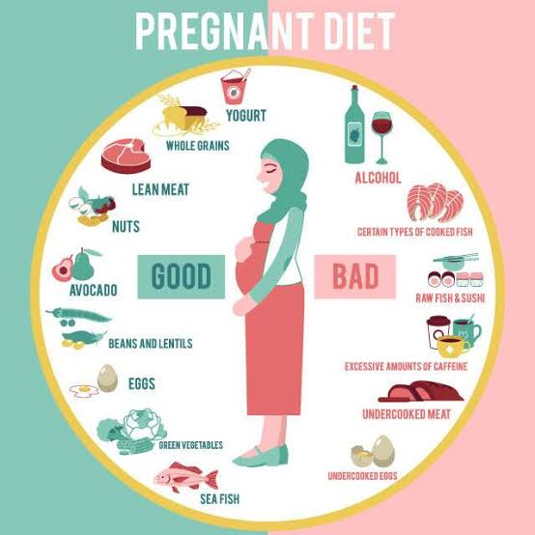

Slide 23


