Slide 1
Diet of Renal Failure
Made by-
SAKIB KHAN
PRAJWAL KHANDAIT

Slide 2
RENAL FAILURE
Renal failure (Kidney failure) is the condition in which the kidneys lose the ability to remove waste and balance fluids.
The Renal system work together with the body’s urine system to collect the body’s waste products and expel them as urine.
Some people do not even know they have kidney disease until their kidney fails. Because people with kidney disease may not have any symptoms. Symptoms usually show up later in the progression.

Slide 3
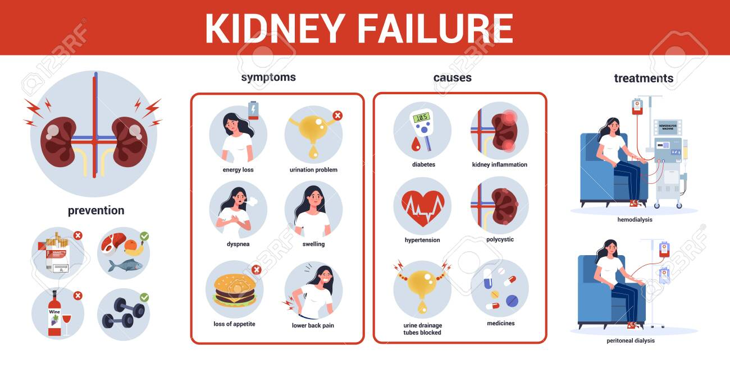

Slide 4
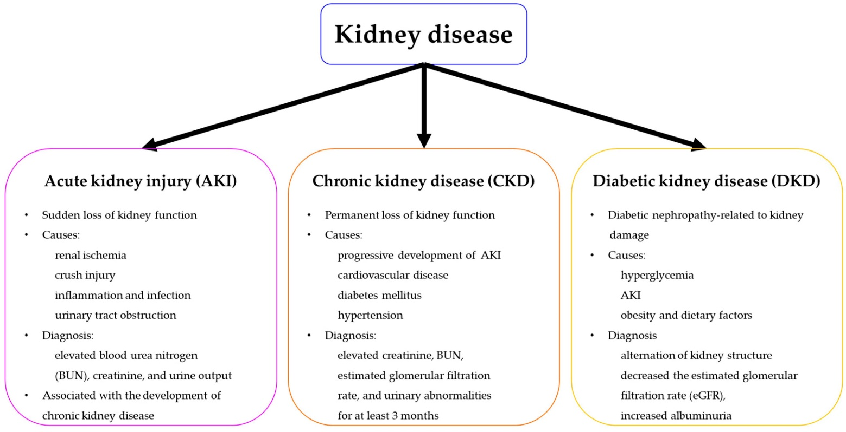
;;;;;;;;;;;;;;;;;;;;;;;;;;;;;;;;;;;;;;;;;;;;;;;;;;;;;;;;;;;;;;;;;;;;;;;;;;;;;;;;;;;;;;;;;;;;;;;;;;;;;;;;;;;;;;;;;;;;;;;;;;;;;;;;;;;;;;;;;;;;;;;;;;;;;;;;;;;;;;;;;;;;;;;;;;;;;;;;;;;;;

Slide 5
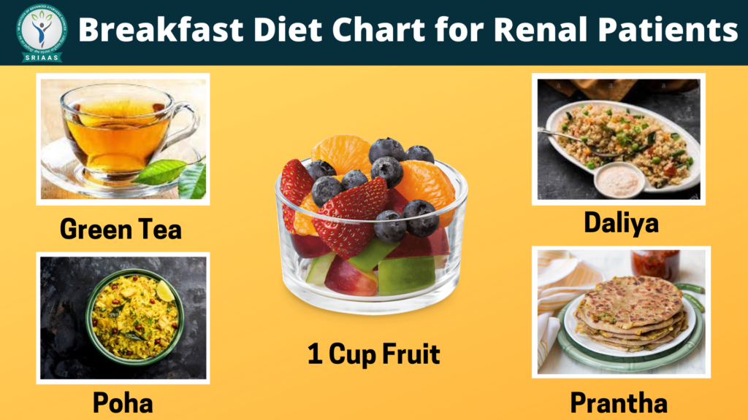
Breakfast Diet For Renal Patient
Patients can take herbal made green tea that
includes ginger, red glover, basal leaves, cardi-
mom, etc.
Renal patient can take lukewarm water with
basal (tulsi) leaves.
Black tea
Ajwain tea
Things to avoid in breakfast consumption of tea and coffee. It will make blood acidic.

Slide 6


Slide 7
What to avoid ?
The patient must sure that they should not take curd.
They can consume any spices but they must sure to avoid chili and salt in their meal.
They also should avoid all sour eatables.
Lemons are great addition to a kidney friendly diet. They are low in potassium and plus contain high levels of citric acid which prevent kidney stones from forming.

Slide 8
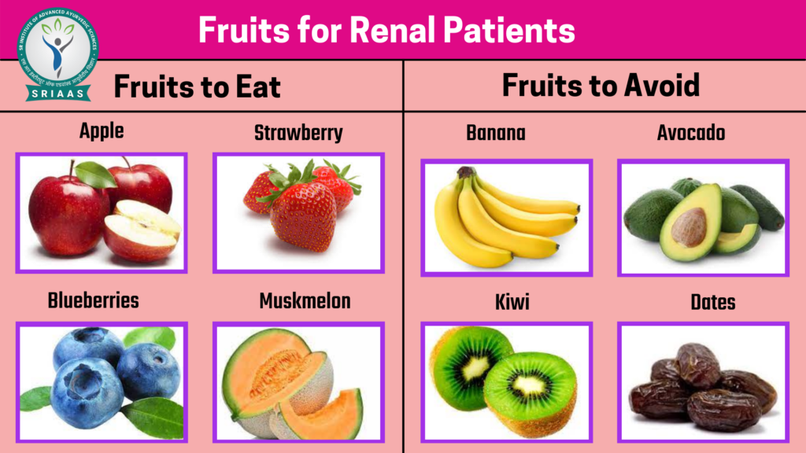

Slide 9
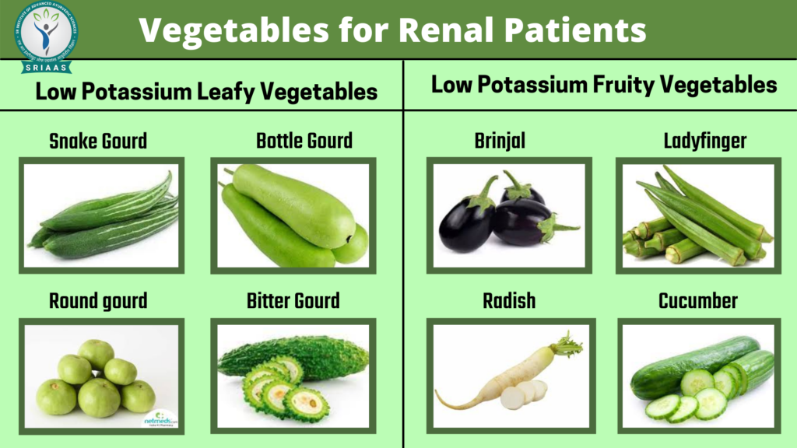

Slide 10
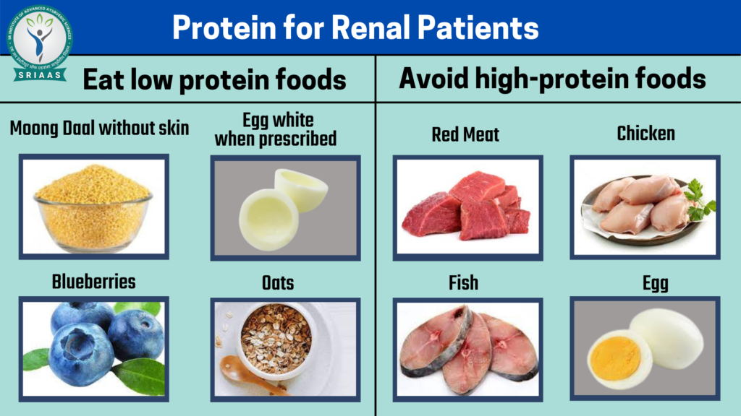

Slide 11
Maintenance of Electrolyte Balance
The kidneys function to regulate electrolyte concentrations.
When the kidneys fail, electrolyte levels are not maintained-
Potassium
Sodium
Phosphate
Calcium

Slide 12
What To Consume?
Low Potassium containing Food:- Apple, Berry, Corn, Carrot, Spinach, etc.
Low Sodium containing Food:- Tomato, Brinjal, Broccoli, Beets, etc.
Low Calcium containing Food:- Strawberries, Asparagus, Rice, etc.
Low Phosphorus containing Food:- Cucumber, Onion, Raddish, Green beans, etc.

Slide 13


