Slide 1
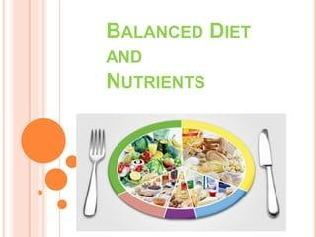

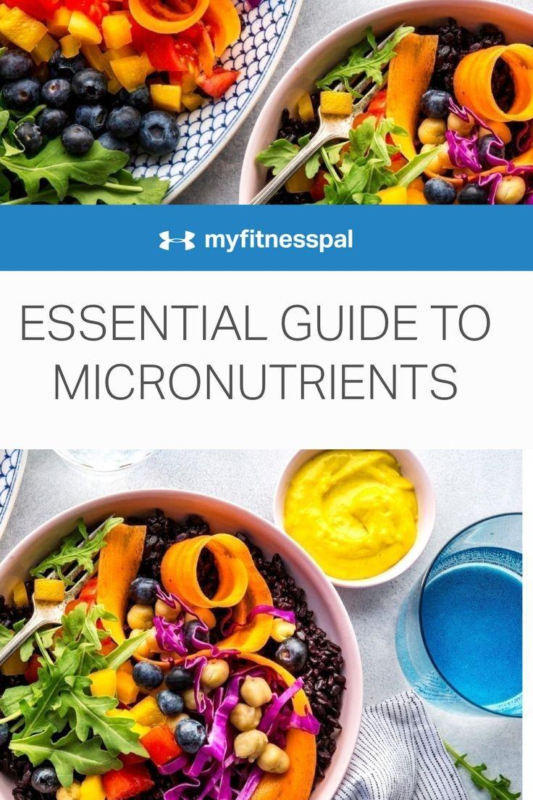
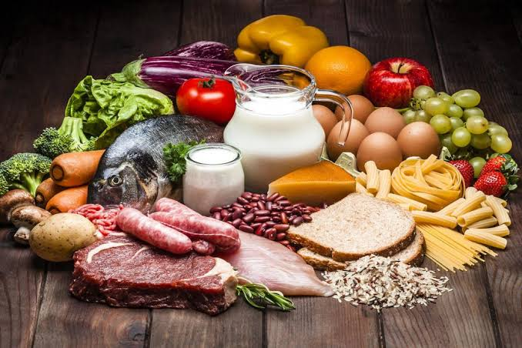
Dietary advice for optimal health in Adulthood
Maintaining a Balanced Diet for a Healthier Life

Slide 2
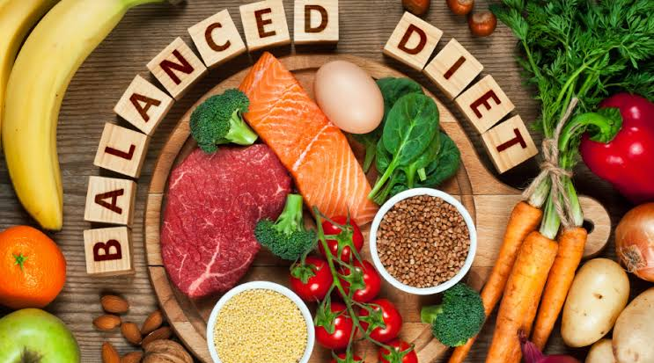
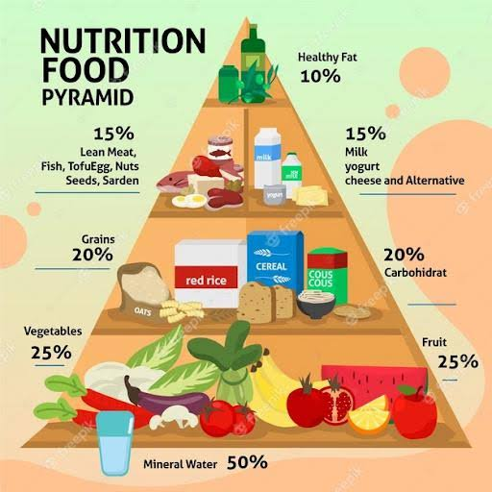

★ Importance of following a suitably prescribed diet ★
A sound knowledge of the principles of Nutrition is of paramount importance in developing countries where more than 50% populations are below the poverty line.
During the last two decades the prevalence of non communicable diseases as increased in India and lifestyle modification plays a crucial role in disease prevention and management. The two aspects of lifestyle modifications are diet and exercise.
Dietetics is the science of food and nutrients, their action, interaction and balance in health and disease, to which biochemists have largely contributed. Features of an appropriately prescribed diet :→
A prescribed diet should be balanced, well planned containing all essential nutrients.
It should be simple, locally available, palatable and digestible.
Adequate protein content should be supplied by a cereal pulse mixture with additional animal proteins.
Calorie intake should be correct and should balance energy expenditure. Care should be taken to see that adequate quantity of calcium and iron are obtained from the diet.
It should provide adequate roughage and have variety.
" Nourish your body, feed your soul.You are what you eat, so choose wisely."

Slide 3
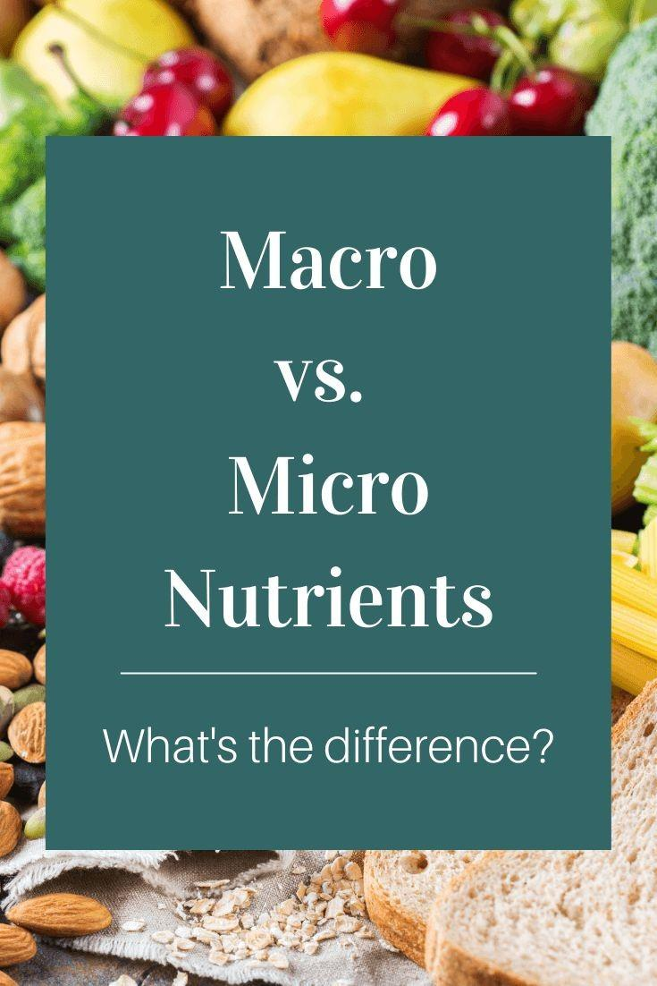
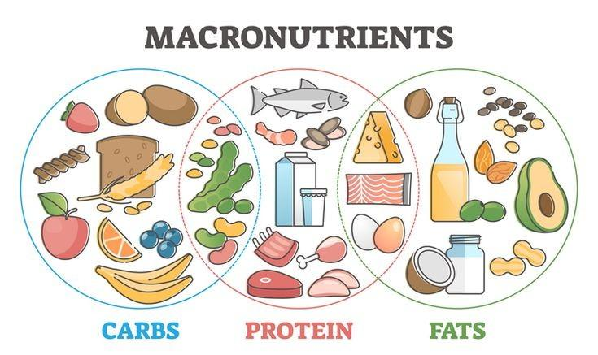
Key Nutrients: Macronutrients…
The dietary carbohydrates provide major fraction of body's energy needs. Ideally carbohydrates may provide 60-65% of the total calories.
The RDA for carbohydrates was recommended at a minimum of 100- 130 g per day for 1 year and above. (minimum amount required for adequate glucose consumption by the brain) In addition to calories, the carbohydrates provide dietary fiber the RDA ofwhich given as 30 g/2000kcal.
Fats provide concentrated source of energy. In developed countries, the percentage of calories derived from fats may be as high as 40%, but in the developing countries it is less, around 10%.
Visible fats consumed as such are butter, ghee and oils. Recommended daily intake of visible fat is 10% of calories or 20 g/day. Invisible fat is present in egg, fish, meat, cereals, nuts, and oilseeds Even cereals contain 1g/100g. More than half of essential fatty acid in Indian diet is in the form of invisible fat.
Proteins from the building blocks for body tissues only 10- 15% of the total energy is derived from proteins. During starvation, Amino acids may act as energy sources. Proteins are the only source of Essential amino acids.
As per WHO/FAO recommendation, the safe level of protein intake for an adult is 0.75 -0.8 g/kg/day. Structural proteins themselves serve as storage proteins To me Et the emergency needs of the body in contrast to lipids and carbohydrates, which have storage forms.

Slide 4
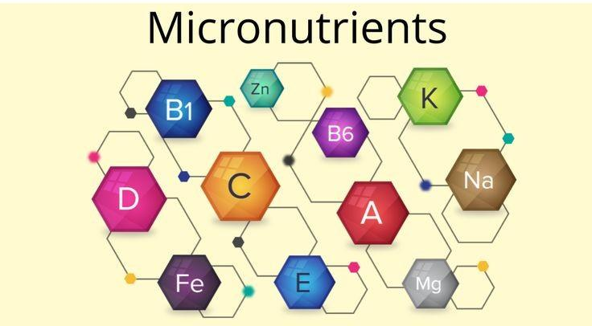
Key Nutrients: Micronutrients…
Vitamin A: Food Sources: Carrots, sweet potatoes, spinach, and liver.Daily Requirement: Around 700-900 micrograms for adults.
Vitamin C:Food Sources: Citrus fruits, strawberries, bell peppers.Daily Requirement: 75-90 milligrams for adults.
Vitamin D:Food Sources: Fatty fish (salmon, mackerel), fortified dairy products.Daily Requirement: 600-800 IU for adults.
Vitamin E:Food Sources: Nuts, seeds, spinach, and broccoli.Daily Requirement: 15 milligrams for adults.
Vitamin K:Food Sources: Leafy greens (kale, spinach), broccoli, and brussels sprouts.Daily Requirement: About 120 micrograms for adult men and 90 micrograms for adult women.
B Vitamins (B1, B2, B3, B6, B12):Food Sources: Whole grains, poultry, fish, eggs, and dairy products.Daily Requirement: Varies by specific B vitamin, but generally a few milligrams or micrograms daily.
Calcium:Food Sources: Dairy products, leafy greens (kale, collard greens), fortified plant-based milk.Daily Requirement: About 1000-1300 milligrams for adults.
Iron:Food Sources: Red meat, beans, lentils, and fortified cereals.Daily Requirement: Approximately 8-18 milligrams for adults.
Magnesium:Food Sources: Nuts, seeds, whole grains, and leafy greens.Daily Requirement: Around 310-420 milligrams for adult men and 255-320 milligrams for adult women.
Potassium:Food Sources: Bananas, oranges, potatoes, and spinach.Daily Requirement: About 3500-4700 milligrams for adults
.Zinc:Food Sources: Oysters, red meat, poultry, and beans.Daily Requirement: Approximately 11 milligrams for adult men and 8 milligrams for adult women.
Iodine:Food Sources: Seafood, iodized salt, and dairy products.Daily Requirement: Around 150 micrograms for adults.

Slide 5
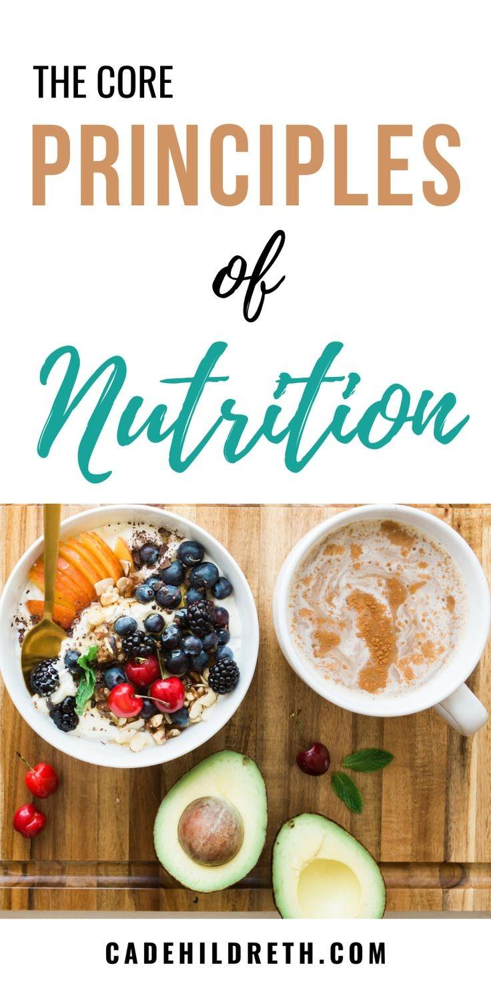
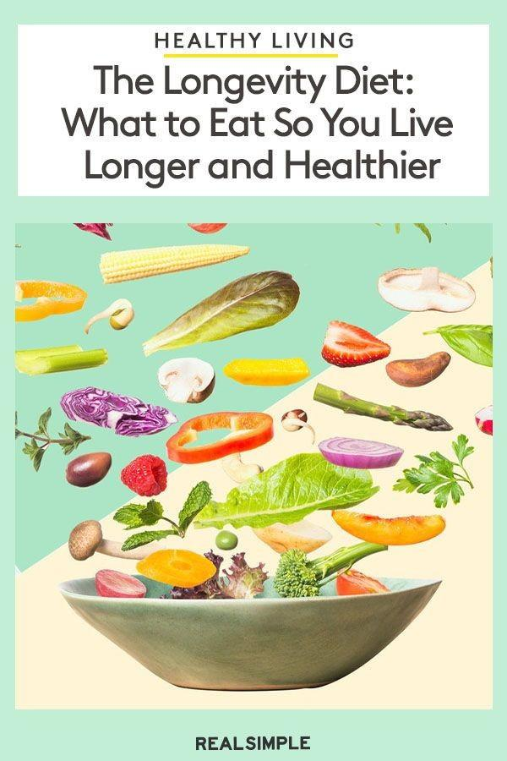
General principles of diet prescription:
● The ideal body weight: The underweight person should be given more nutrients. And overweight person should reduce the calorie intake. The reference man has a body weight of 65 kg and a woman 55 kg with BMI between 18.9 and 23 in the age group 19 to 30.
● Protein Requirement is about 1g/kg body weight for adults and 2 g/kg for children. During pregnancy and lactation, protein requirement is about 2.5 g/kg.
● Calorie requirement: As a rule, The calorie requirements for a person is taken as 30 to 35 kcal per kg of ideal body weight. For sedentary habits, lower values (30 kcal) and for moderate muscle activities, higher values (35 kcal) are prescribed. Average calorie requirement for an avg adult Indian female and male will be between 1700 Kcal/day and 2300 kcal/day respectively.
● Ratio: Balance diet should contain calories from Carbohydrates, proteins and fat in the ratio of 60:20:20, the New concept recommends 40% of energy from cereals and millets, 17% from pulses and flesh food and 10% from milk and Milk products.

Slide 6
Steps in diet prescription for Adults :
■First step: Calorie requirement: For a 65 kg sedentary man, The approximate energy requirement is 1950Kcal plus an additional allowance for specific dynamic action=195 kcal. Therefore, the total requirement is roughly 2145Kcal.
■Second step: Proximate principles: A person requires 55g proteins, giving 220Kcal of energy. The total requirement is 2000 KCal. Carbohydrates and fat should produce 1780Kcal. about 20% of total calories are supplied by fat, therefore, fat should supply 360K cal, which is about 40g fats. The calculation is based on the fact that 1g carbs produce 4kcal, 1g fat supplies 9kcal, and 1g protein gives 4kcal.
■Third Step: General composition of Food: Calculate how these proximate principles are supplied as common food stuffs. For the exercise, we should familiarize with the nutritive value of food stuffs.
■Fourth step: Determine the food items: Knowing the requirement and nutritive value of food stuffs, it is possible to write down the items of food. A fundamental principle of dietetics is food exchange. It is very useful for calculation of proximate principles. Accordingly foods with similar nutrient composition are grouped together.

Slide 7
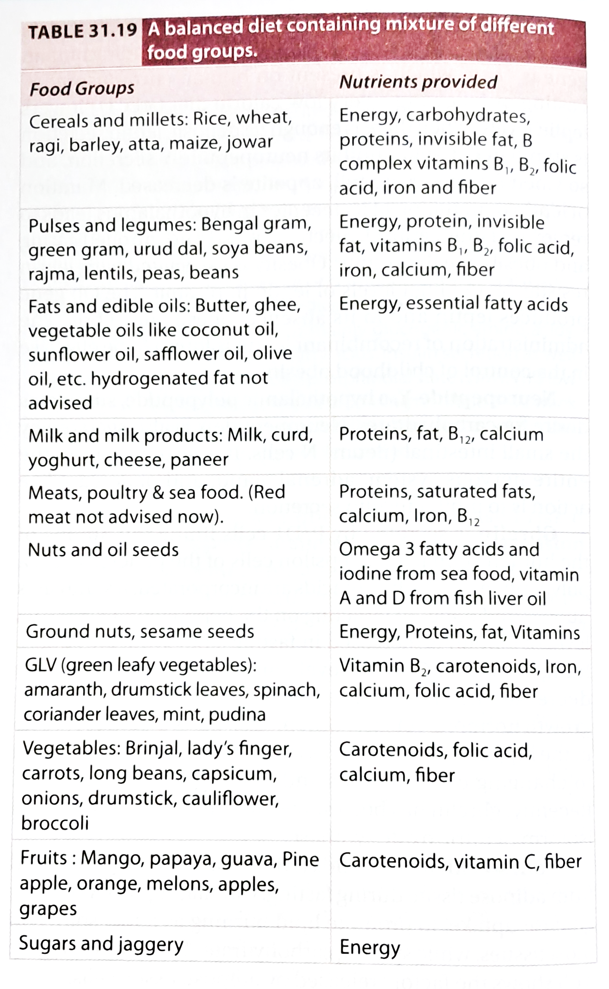
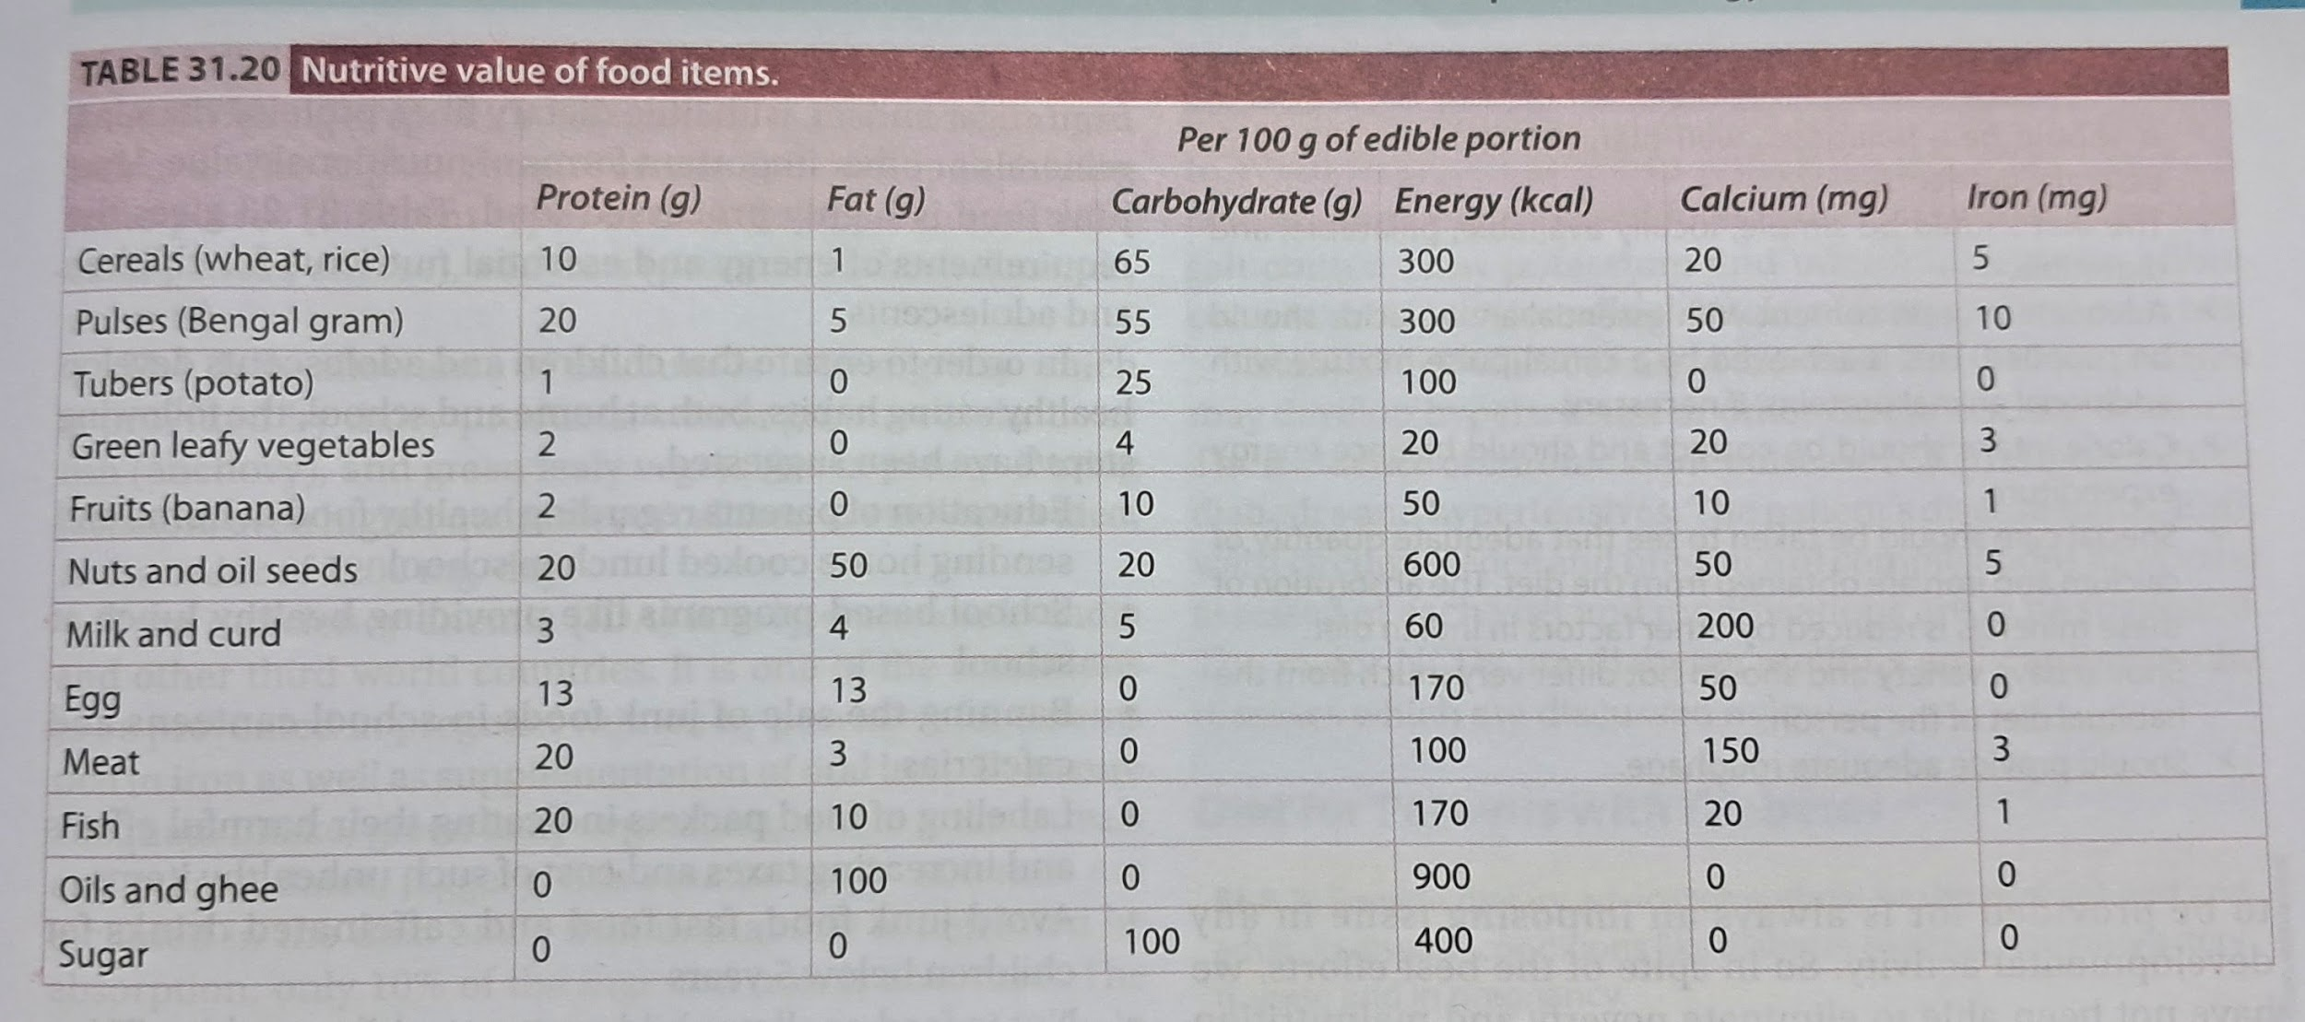

Slide 8
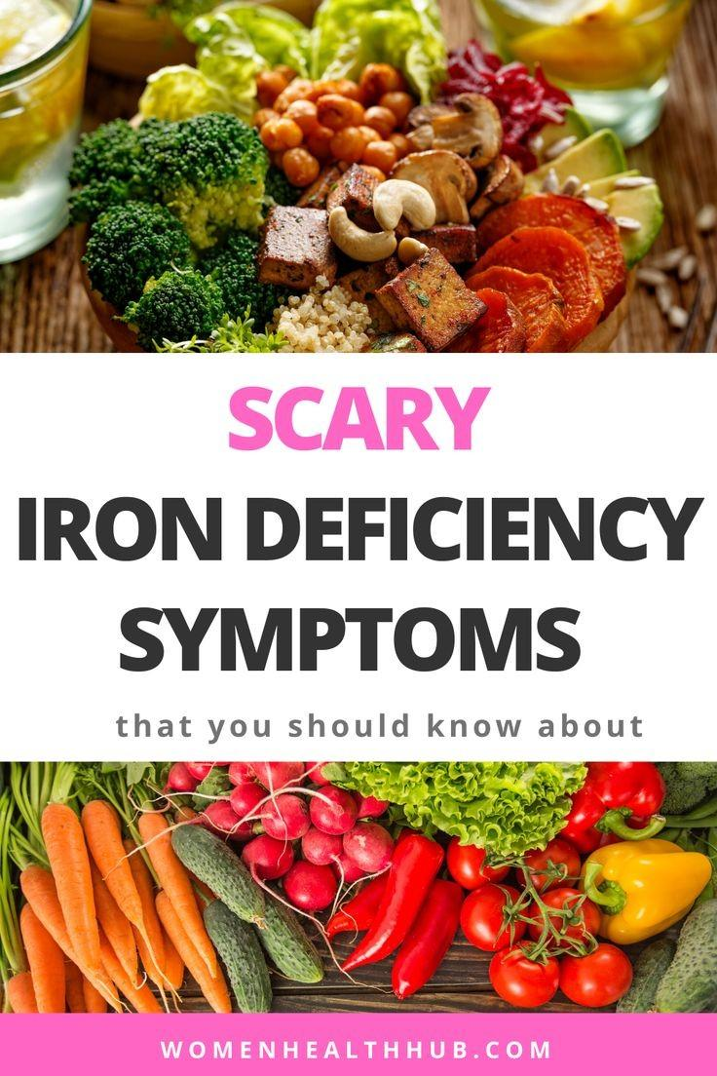
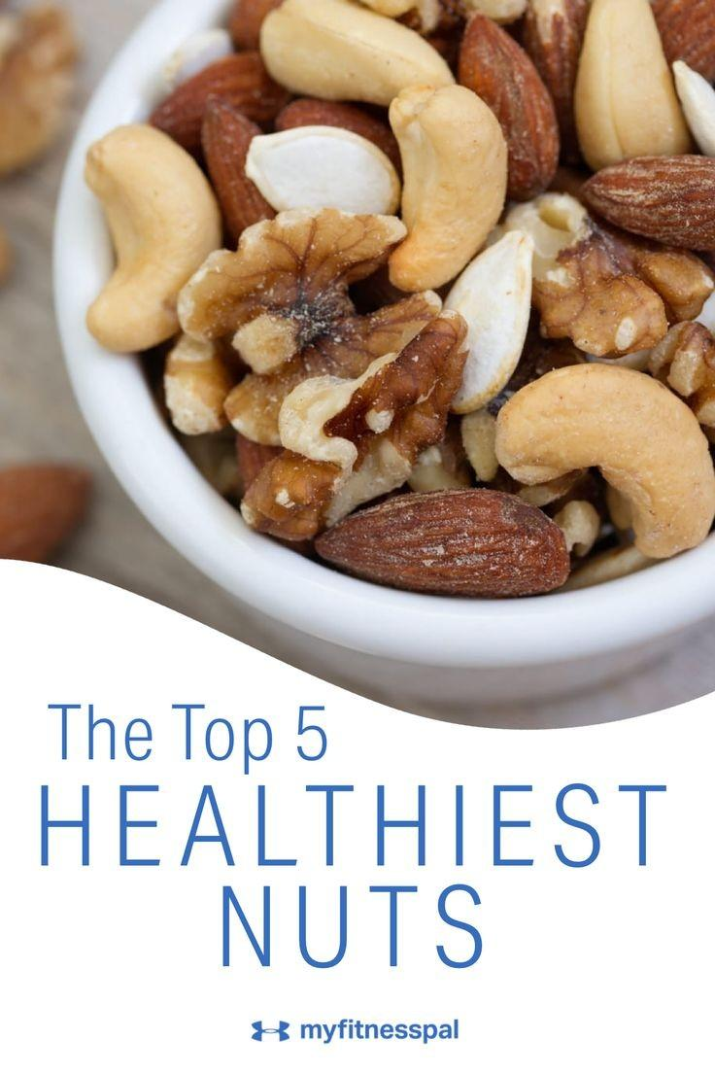
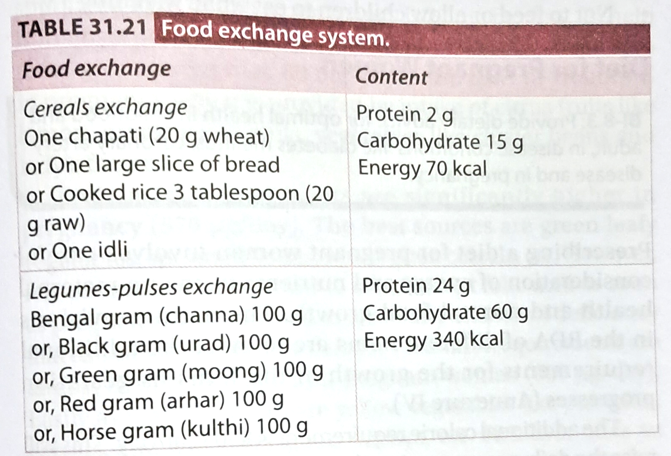
Food Exchange System :
Table 31.21 shows that one chapati or one Idli or 1 large slice of bread will give equal quantities of energy and proteins. They are nutritionally equivalent. Legume pulse exchange system is described in table 31.21
Mutual supplementation of Cereals-pulses:
The protein content of purses is more than cereals, average Indian diet contains more cereals and hence proteins are mainly supplied by cereals but pulses give good quality proteins.
A combination of cereals and pulses provide all essential amino acids (pulses are deficient in methionine and cereals lack lysine) An accepted formula is that the food should contain pulses and cereals in the ratio of 1:5 to produce provide good quality proteins.
Supplementing the cereals with animal proteins is certainly a good way to improve the quality but at a higher cost. Fruits and vegetables will provide vitamins and minerals. Vitamin A is available in ripe mango, papaya, carrot, beetroot and other leafy vegetables. Vitamin B complex may be supplied by cereals and green leafy vegetables. Major sources of calcium are milk, cereals, pulses, green leafy vegetables. Iron is mainly supplied by pulses, cereals, vegetables, meat and liver. Jaggery is a good source for iron. Jaggery is therefore superior to refined sugar, Especially for children. Milk is a very poor source for iron.

Slide 9
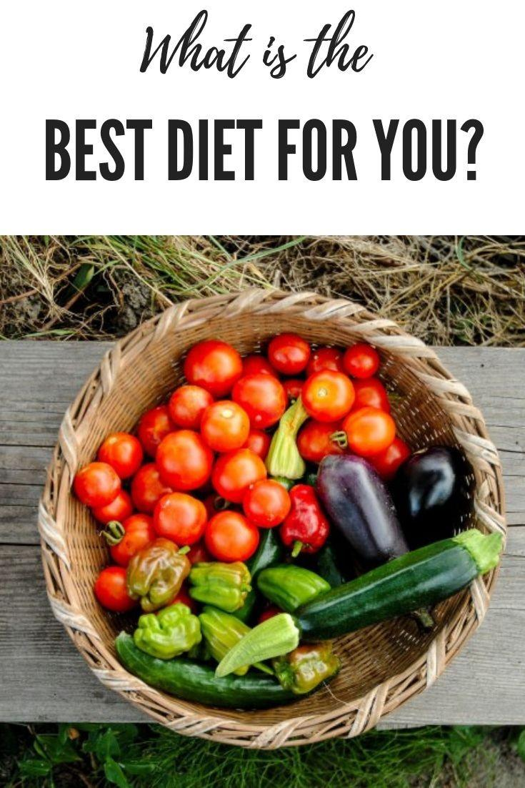
Dietary Restrictions
Consumption of alcohol and caffeine should be approached with moderation and responsibility for overall health and well-being. Here are some recommendations:
Know your limits
Stay hydrated
Avoid binge drinking
Never drink and drive
Respect legal drinking age
Dietary restrictions are crucial for individuals with special health conditions such as diabetes, celiac disease, food allergies, and heart disease. These restrictions help manage the condition and promote overall well-being. It's essential to consult a healthcare professional when implementing dietary changes to ensure they are safe and effective. Healthcare professionals can provide personalized guidance, monitor progress, and make adjustments as needed. This collaboration helps individuals make informed choices and maintain their health while accommodating their specific dietary needs.

Slide 10
Maintaining healthy habits- for optimal health
A healthy diet and regular physical activity are key components of a holistic approach to health. They complement each other in various ways:
1. Weight Management: A balanced diet and exercise help maintain a healthy weight, reducing the risk of obesity-related diseases.
2. Cardiovascular Health: Regular physical activity strengthens the heart, while a healthy diet low in saturated fats and sodium supports cardiovascular health.
3. Energy Levels: Proper nutrition provides the energy needed for physical activity, enhancing overall vitality.
4. Mental Health: Exercise releases endorphins, improving mood, while a nutritious diet can support brain function and mental well-being.
5. Disease Prevention: A combined approach can help prevent chronic conditions like diabetes, heart disease, and certain cancers.
6. Muscle and Bone Health: Exercise, particularly weight-bearing activities, supports muscle and bone strength, and a balanced diet provides essential nutrients for these tissues.
7. Longevity: The synergy of diet and exercise can contribute to a longer, healthier life.
To achieve optimal health, it's important to strike a balance between the two, making them integral parts of your lifestyle.

Slide 11
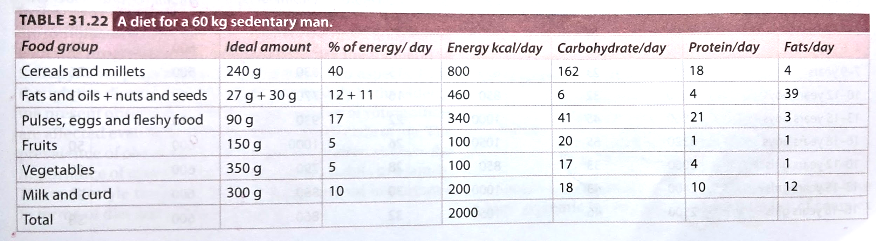
PRESCRIBING A NORMAL DIET: Now We can assemble this knowledge to prepare a diet. To suit the requirements, the result is given in the table. This will satisfy the requirements regarding protein. (55 g), fats (40 g), calories (2000 kcal), calcium (1000 mg) and iron, (25 mg). Cereals-pulses ratio is maintained at 5 to 1 when calories alone are to be increased as in case of a person having severe muscular exercise, tubers and roots will serve the purpose. The total quantities of principles thus calculated are divided into breakfast, lunch, and supper- three meals per day.

Slide 12
Thank you….
~Roll no 43,44

